Slide 1
Chapter 7
Generating Functions

Slide 2
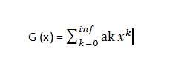
What is Generating Function?
Generating Function:

Slide 3
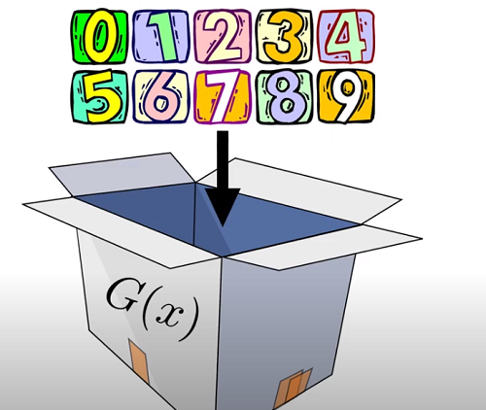
What is Generating Function?
Generating Function: A companion trick to record bunch of numbers often probabilities associated with some integers and counts.

Slide 4
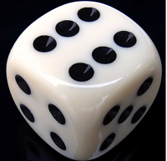
Generating Functions
Let’s imagine a dice , it’s a good looking dice but not perfect having the probability
Of a number.
Probability of number 1 is P1
Probability of number 1 is P2
Probability of number 1 is P3
Probability of number 1 is P4
Probability of number 1 is P5
Probability of number 1 is P6

Slide 5

Generating Functions
Can you create the function which can contain all the information of these Probabilities?
So that we can calculate all the probability values.
Now, we need a way to isolate these values. The simplest way to do that by using a polynomial.
So,

Slide 6
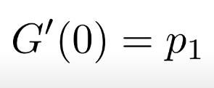
Generating Functions
So,
How can we get P1 from this function? Let’s take first derivative

Slide 7
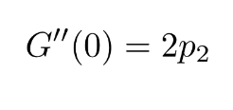
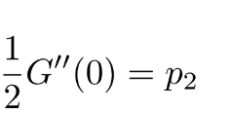
Generating Functions
So,
How can we get P1 from this function? Let’s take first derivative
How about P2? We will take another derivative.

Slide 8
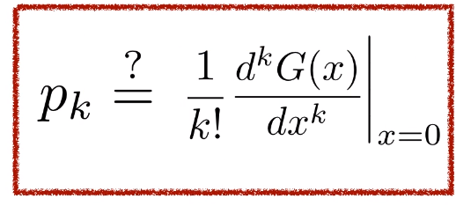
Generating Functions
What about Pk?

Slide 9

Generating Functions
Now Le’ts think again.
If x=1, what will happen to first derivative/

Slide 10
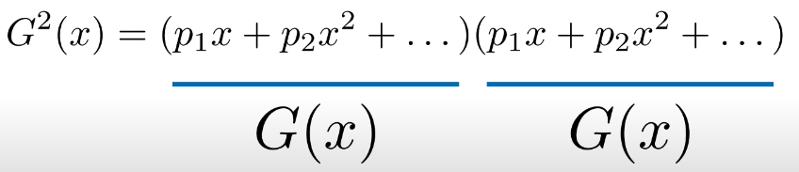
Generating Functions
Another cool thing happens if we multiply our generating functions.
G(x) * G(x)

Slide 11
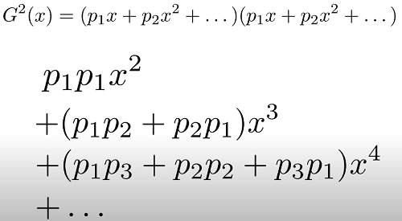
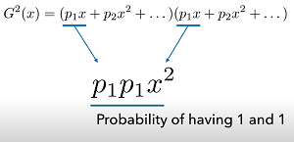
Generating Functions
The lowest power of x will be 2 and the highest will be 12
So, do you see any patterns?
Let’s imagine the number of dice is 2.
Now, think the probability having 2.

Slide 12

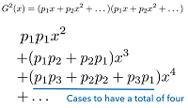
Generating Functions
Is this a coincidence?
Let’s see another case. To have 4 in total, you should have
1, 3
2, 2
3, 1
So total num of ways of having 4 = 3

Slide 13
Generating Functions
If we multiply G(x) with another G(x), then the resulting function will be another generating function.
So from Generating Functions, we can say
Counting problem is so easy
To study random graphs without arbitrary distribution
So, Let’s go for another example

Slide 14
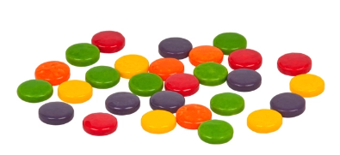



Generating Functions
Now , we you want to choose 10 candies from this bunch of red, blue
And green candies.
Somehow, you want to have
Even number of red candies
More than 6 blue candies
Less than 3 green candies

Slide 15
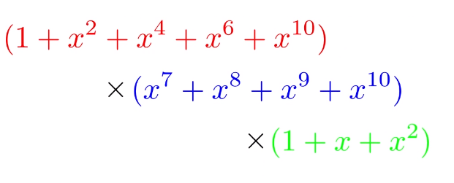
Generating Functions
Now from this Generated function
You will find the coefficients of X^10
The number of coefficients will be
The ans of choosing 10 candies from
These bunch of candies.

Slide 16
Problem no 1
A girl can choose two items from the basket containing 1 apple, 1 pear, 1 orange, 1 banana and 1 papaya. How many ways she can do this?
Let’s see the solution:
(0 apple + 1 apple) (0 pear + 1 pear) (0 orange + 1 orange) and like so on…………….
(x^0 + x^1) (x^0 + x^1) (x^0 + x^1) (x^0 + x^1) (x^0 + x^1)
= (1 + x )^5
= 1 + 5x + 10x^2 + 10x^3 + 5x^4 + x^5
So, she wants to choose 2 items. Now look at the x^2 coefficient which is 10.
The ans is : 10.

Slide 17
Modifying Problem no 1
Suppose there are 2 apples (considered to be identical) instead of 1. Rest of all the items are same. Now how can the two items be chosen?
Solution:
(0 apple + 1 apple + 2 apple) (0 pear + 1 pear) (0 orange + 1 orange) and like so on…………….
= (x^0 + x^1 + x^2) (1 + x )^4
=(1+x+x^2) (1+x)^4
= (1+x+x^2) (1 + 4x + 6x^2 + 4x^3 + x^4)
= ( 1 + 4x + 6x^2 + 4x^3 + x^4 + x + 4x^2 + 6x^3 + 4x^4 + x^5 + x^2 + 4x^3 + 6x^4 + 4x^5 + x^6
= (6 + 4 + 1) x^2
=11 x^2
Ans: 11 ways.

Slide 18
Problem no 2
Suppose you go to a bakery just before it closes. Remaining there are 3 cheese, 2 cherry and 4 raspberry pastries left. How many ways can you choose exactly 7 pastries?
Solution:
(x^0 + x^1 + x^2 + x^3 ) (x^0 + x^1+ x^2) (x^0 + x^1 + x^2 + x^3 + x^4)
Cheese cherry raspberry
= 1 + 3x + 6x^2 + 9x^3 + 11x^4 + 11x^5 + 9x^6 + 6x^7 + 3x^8 + x^9
= 6 ways.
So , if we want to know the ways to choose of 5 pastries or 4 pastries. You can give ans from this simple one equation. Isn’t it??

Slide 19
Modifying Problem no 2
What if the raspberry pastries come in box of 2 (that means in even numbers)? Other amounts of problem 2 remains same? Now how many ways to choose 7 pastries?
Solution:
(x^0 + x^1 + x^2 + x^3 ) (x^0 + x^1+ x^2) (x^0 + x^2 + x^4)
Cheese cherry raspberry
= 1 + 2x + 4x^2 + 5x^3 + 6x^4 + 6x^5 + 5x^6 + 4x^7 + 2x^8 + x^9
= 4 ways.

Slide 20
Thank You!!

